Slide 1
MongoDB Installation

Slide 2
Link
https://www.programmersought.com/article/357019450/

Slide 3
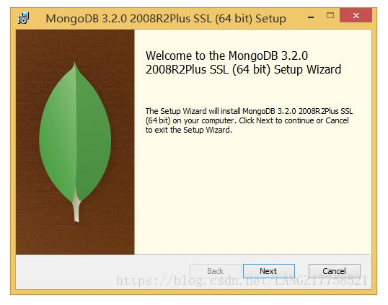
Steps
Double-click mongodb-win32-x86_64-2008plus-ssl-3.2.0-signed.msi to launch the installation wizard interface. Select the "Next" button

Slide 4
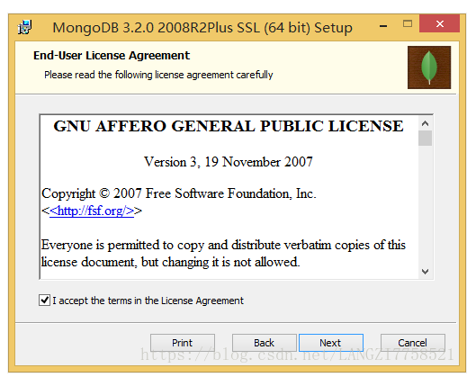
Steps
Accept the agreement, Next

Slide 5
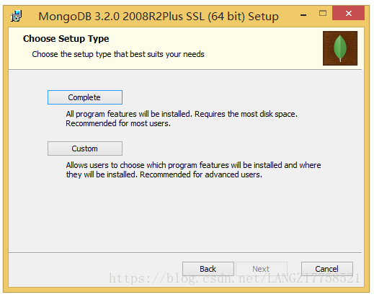
Steps
Complete installation path defaults to C:\Program Files\MongoDB. If you want to customize the installation path, you should select Custom.

Slide 6
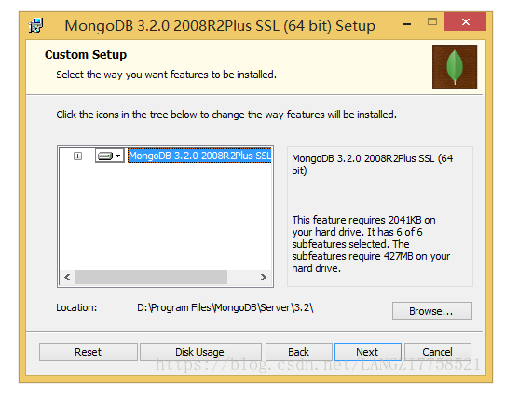
Steps
Change the installation location from the default C:\Program Files\MongoDB\Server\3.2\
D:\Program Files\MongoDB\Server\3.2\
Select "Next"

Slide 7
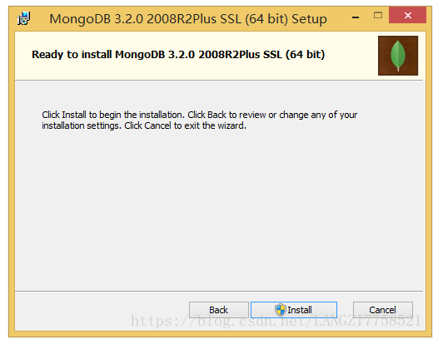
Steps
choose Install

Slide 8
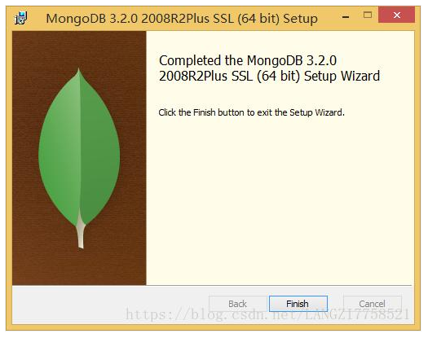
Steps
choose finish

Slide 9
Steps
Third, create a data file storage directory e: \ db
Fourth, start the MongoDB service
Open the cmd console as an administrator and go to D:\Program Files\MongoDB\Server\3.2\bin

Slide 10
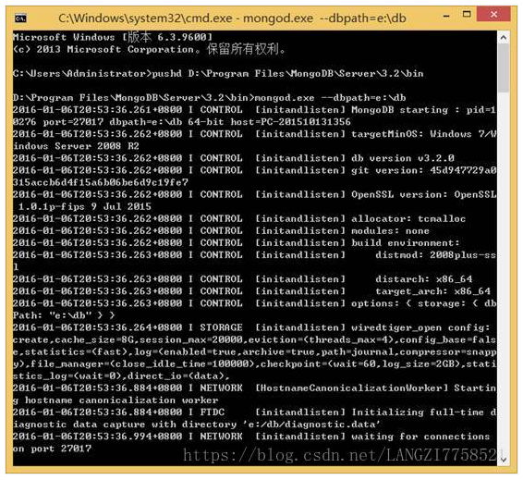
Steps
Execute mongod.exe --dbpath=e:\db
the default port used by MongoDB is 27017.

Slide 11
Steps: Random start of MongoDB as a Windows service
First create a log file storage directory D:\Program Files\MongoDB\Server\3.2\logs\
Installing System Services
In the cmd window, press Ctrl+C to exit the mongod process, and then execute the following command.
mongod --dbpath=e:\db --logpath="D:\Program Files\MongoDB\Server\3.2\logs\mongodb.log" –install
Open the service window of the operating system and find that the MongoDB service has been successfully installed.

Slide 12
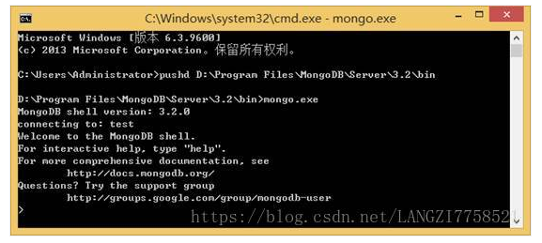
Steps: The client connection
Open a new cmd window and execute mongo.exe under D:\Program Files\MongoDB\Server\3.2\bin

